Slide 1
Boston housing price prediction
By
S.Boshika
960521104017

Slide 2
Agenda
Introduction
Data Cleaning
Decision Tree (baseline model)
Bagging
Random Forest
Boosting
Conclusion

Slide 3
Introduction
Goal: predict sale price of houses in Ames, Iowa.
The dataset has 79 predictor variables, 1 dependent variable SalePrice, and an ID variable.
The train and test data set each consist of 1460 rows and 81 columns.
Evaluation metric: Root Mean Squared Error (RMSE) between logpredictedvalue and logactualvalue.
Split train dataset further into 50% train and 50% test.

Slide 4
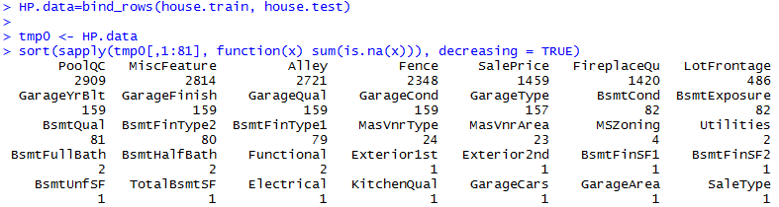
Data Cleaning
Converting NA to None for some categorical variables, e.g. NA in Alley meant “No Alley Access”
Converting NA to most occurring value for some categorical variables, e.g. KitchenQual
Converting NA to average value for certain numeric variables, e.g. Garage Area
Converting NA to other values for other variables, e.g. NA in GarageYrBuilt = YrHouseBuilt

Slide 5
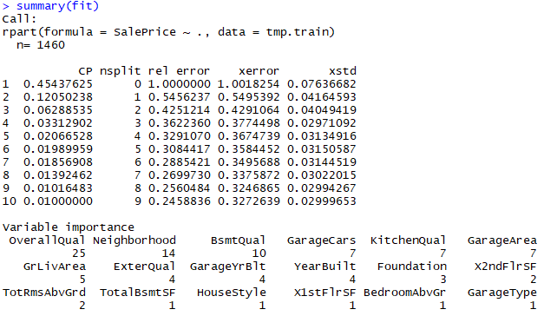

Regression Decision Tree (baseline)
Advantages of decision trees: data preparation, missing values, scale differences, outlier insensitivity, feature selection
Notes:
Decision trees are also not sensitive to outliers since the splitting happens based on proportion of samples within the split ranges and not on absolute values.

Slide 6
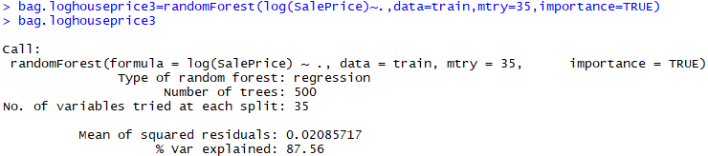

Bagging
Advantages: stable models, reduce variance of estimates, prevents overfitting
Important variables: MSSubClass and MSZoning

Slide 7
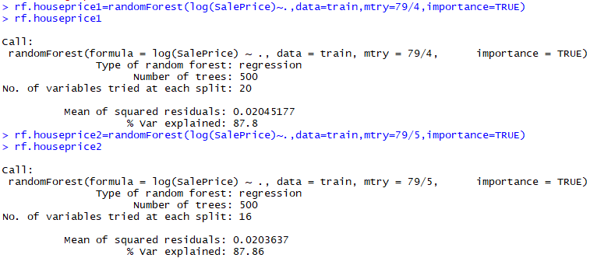

Random Forest
Advantages: data preparation, missing values, feature selection, decrease the overfitting risk
Important variables: MSSubClass and MSZoning

Slide 8
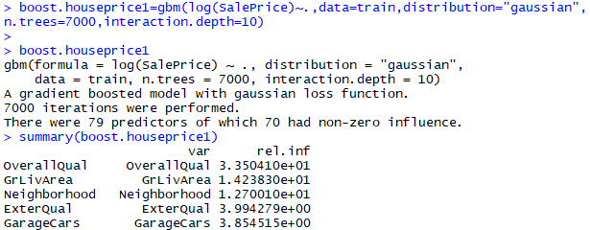
Boosting
Advantages: stable models, reduce variance of estimates.

Slide 9
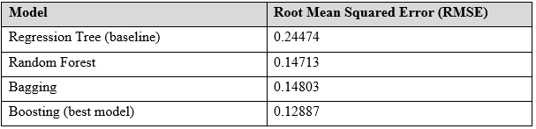
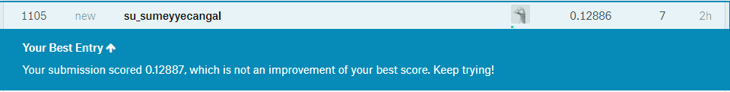
Conclusion
This score also landed us in the top 1105th position out of a total 2923 teams. Hence, we performed better than 62% of the teams.

